Slide 1
ML Continuous Training and Deployment
Francesc Balada
Machine Learning Developer
Barcelona
Notes:
My name is Francesc Balada. I am working as Machine Learning Developer.
Since 4 months ago I live in Barcelona after 12 years abroad.
Today I am going to walk you through my capstone project which is a prototype of a component of my vision.

Slide 2



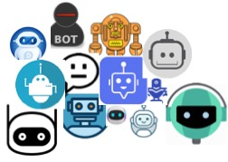
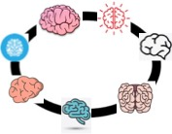
Where are we heading to?
1 Megatron of data
100+ bots
7 to rule them all
Notes:
The vision of the system is to collect as much data as possible. Say the market rates of raw materials such as gold, silver, titanium, oil, … the market rates of all possible stocks. These data will be at the lowest level of granularity possible, 1 minute for instance.
Additionally we will collect the news, tweets, forums, blogs, etc…in summary all the data in the world.
On subsets of these data, we will mainly use reinforcement learning, so that we end up having a bot farm of heopefully just good performing bots. These bots would be constantly training and if improved deployed automatically.
In order to control these decisions, the bot’s actions and their environment, we will develop several brains connected and synchronized. These brains will decide when to deactivate a bot (it could be the case that neither the productive bot, neither its continuous training counterpart are performing, so they should be deactivated. Or how much money each bot has available to trade. Or monitor the system creating observability information and acting accordingly, etc etc

Slide 3


Where are we now?
1997
Stock Market Programs at university
1998
Idea: extract data from newspapers. market rates + news into MS Excel. Apply statistics
2018
Master Thesis Tutoring on Trading Ethereum with Deep Learning
2019
Vision + Gap Analysis = Study Plan
2019
Bot company initiative. Left due to different visions
2021
Bots creation initiative with students
2022
Study Plan completed
Notes:
In my first university studies I visit 2 4-session stock market programs to learn how the stock markets work.
I came up with the idea of linking types of news (political or economical events) with the stock market rates. So I started collecting news papers with the intention to introduce them into an excel an apply some statistics.
So after one year I sat down to introduce the data. I think after half an hour I realized that it was not feasible. So I thought to select some specific ones. I never did it. It was to0 painful.
In the course 2016/2017 I teached a course in a data science master in Vienna. I tutored several master thesis. One was about trading ethereum using deep learning. My thoughts about the idea took verve again and with the changes of techonology and data availability.
I also listened to ray dalio and his principles book. His approach and what he mentioned was Bridgewaters success secret was totally aligned with my view and I envisioned the system mentioned previously.
The same year, in 2019, my ex-mentor founded a company to develop rule based bots. He had been trading (or precisely scalping) for several years, and he and some colleagues of him wanted to automate their rules.
I explained them my vision. Though it did not percolate. It was like talking about flying to the moon for holiday for them and I left the initiative.
In 2021 the master thesis studen contacted me again and we started with 2 other students the creation of a bot. After several months where mainly me was working it, the initiative was closed by lack of time.
So in 2022, today actually, is the milestone of finishing the study plan. Now I now at least the basics of every component part of the system.

Slide 4
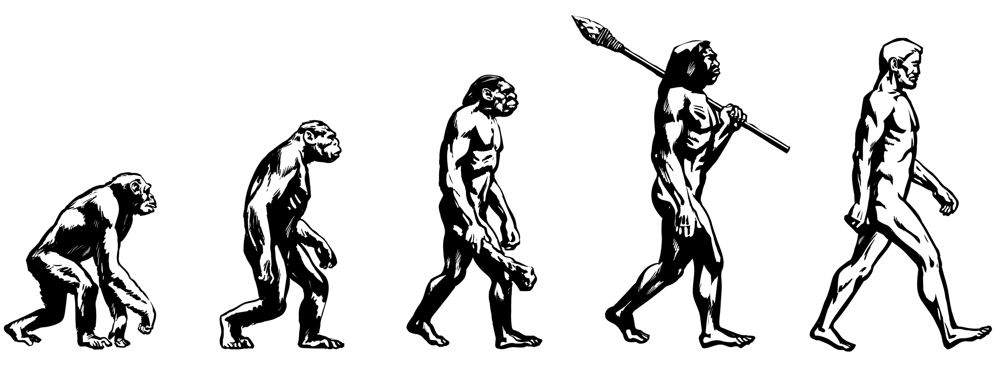
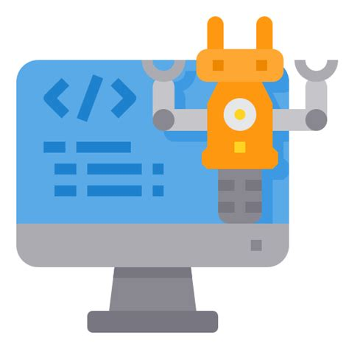
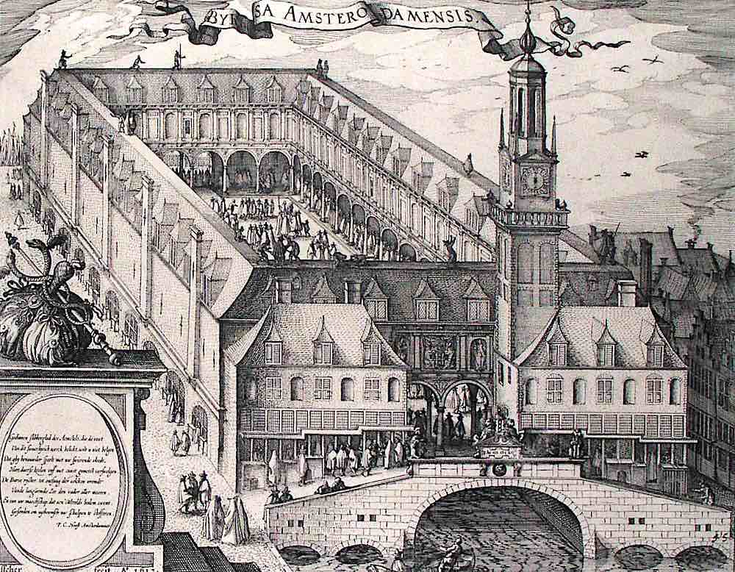
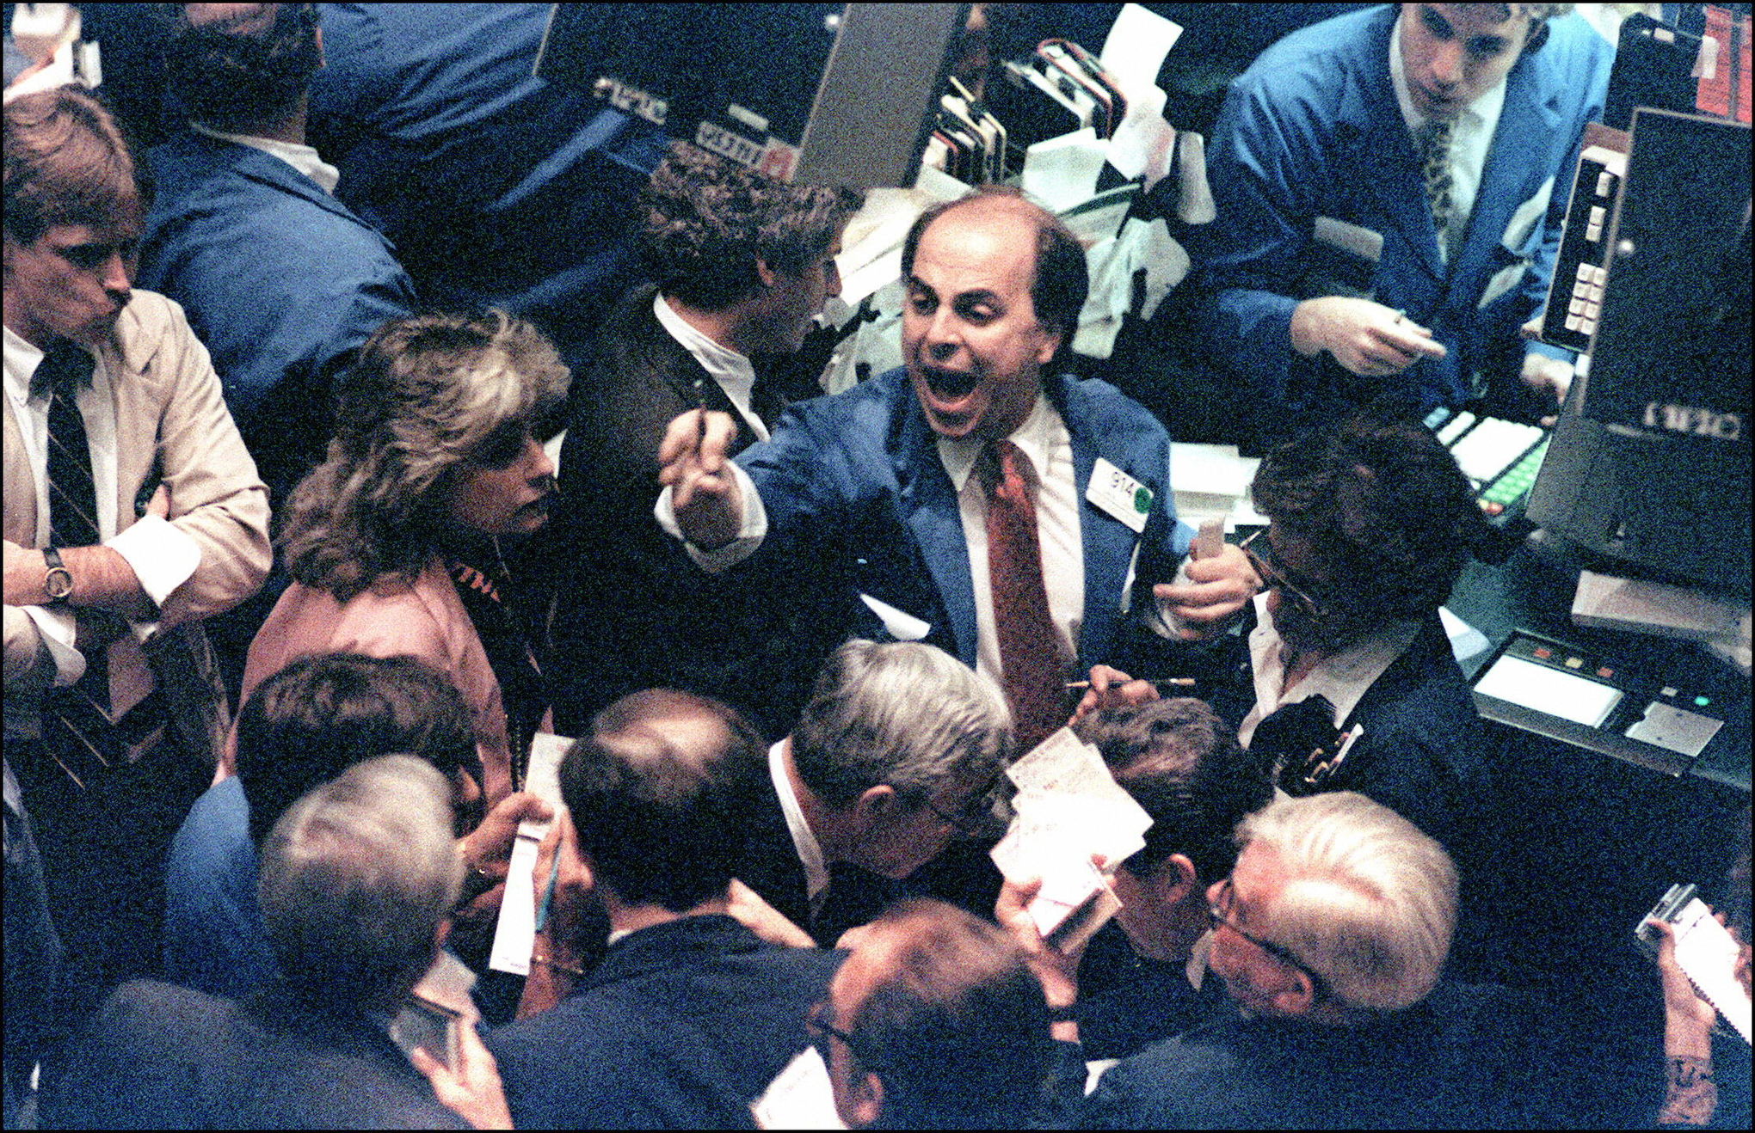
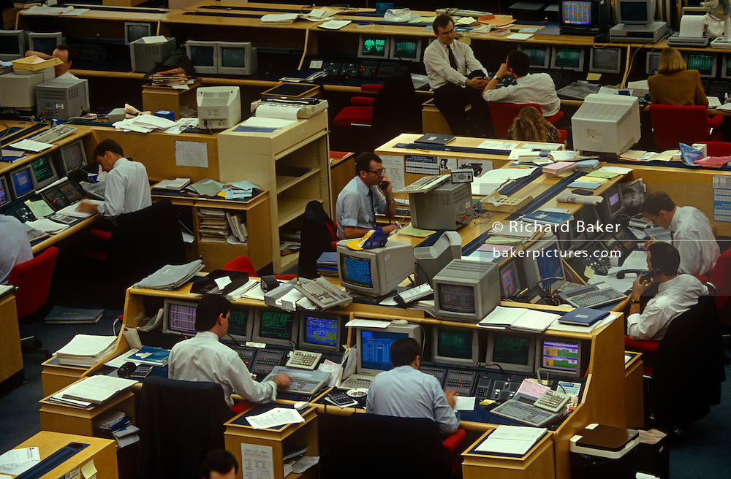
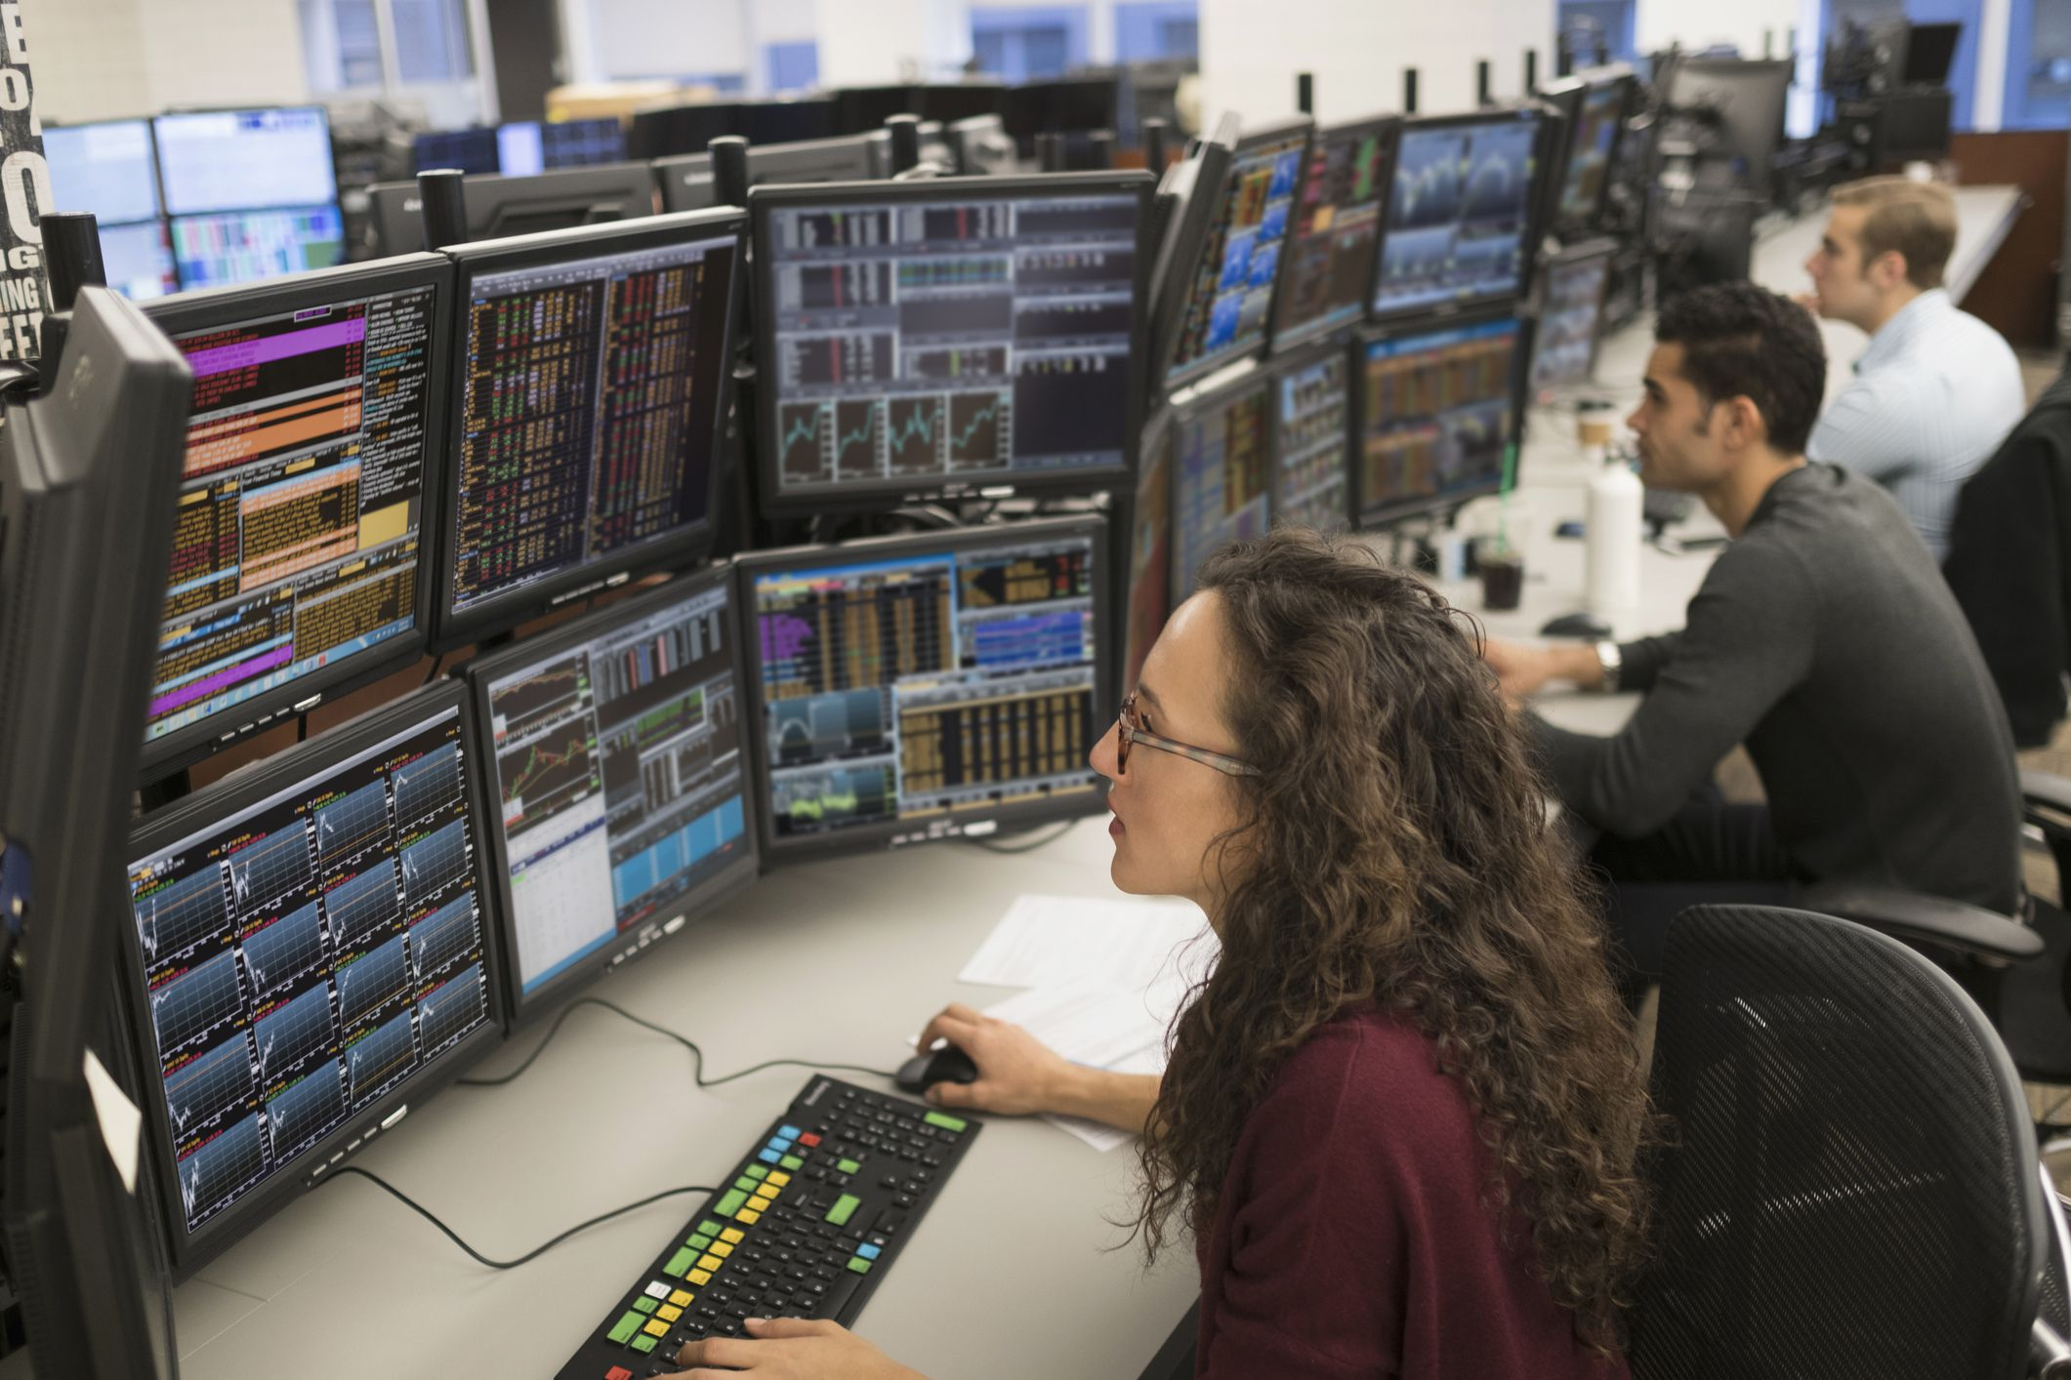
Human evolution
Trading evolution
Notes:
The evolution of trading has evolved in its sofistication. From shouting and paper, through computers, until the automation.

Slide 5
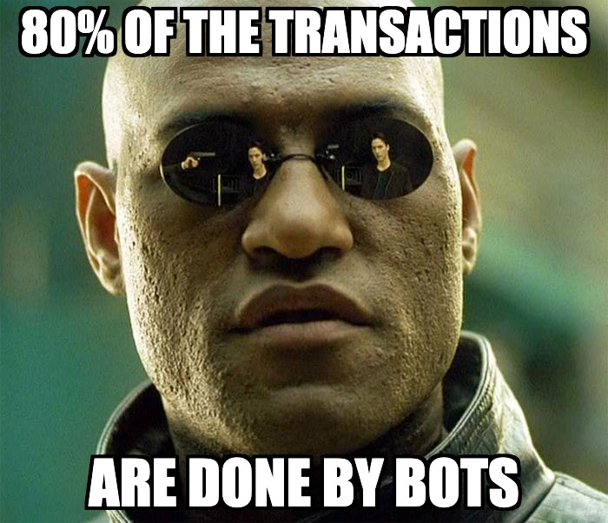
https://www.cnbc.com/2019/06/28/80percent-of-the-stock-market-is-now-on-autopilot.html
https://therobusttrader.com/what-percentage-of-trading-is-algorithmic/
Notes:
it is said that between 60% and 80% of the transactions are done by bots.

Slide 6

What problems do trading bots have?
Small traders do not have infrastructure nor are savvy on how to set it up
Big operator are oftentimes slow evolving and deploying their bots because of their internal processes.
Some trading bots are designed to take advantage of very small inefficiencies. These disappear or change in nature
Much time is spent on finding a set of trading rules, rather than thoroughly backtesting and/or applying intelligent components
Thousands of people are using the same or a similar bot, this may cause the market logic exploited cease to exist
Currently most bots are rule based bots
Notes:
The capacity of the small traders to set up an infrastructure is limited. Bigger companies are slow with their silos way of working.
The design of the bots is problematic. Most of the bots are rule based bots. They try to take advantage of findings of a clever guy or a clever team.
They might have identified a small inefficieny in the market, or new rules. They hard code them, and when the back testing is limited. They have to use the tools each platform offers which are not the quickest in the world.
Also, every test is a manual test. The results are then collected and imported into Excel with 40 tabs. In the first tab they have a dashboard and some very clever calculations.
The process is very manual and error prone.

Slide 7

Leverage the opportunities
Where can we shine? What do we do well?
Optimize rules and train ML models
Get valuable information out of structured and unstructured data
Build infrastructure to support heavy data processes
Automate or facilitate most of the steps from idea to production

Slide 8
Build an infrastructure to optimize a model and deploy it if it becomes better
Goal of the capstone
When does it mean to become better in the capstone setup?
Production Mean Squared Error is higher than 1
Candidate MSE is 2/3 lower for 3 consecutive times
When would it mean to become better for a bot to be deployed in a real scenario?
The candidate bot is 25% more profitable than the production bot in the last 6 weeks
The candidate bot has a 10% more profitable transactions with a 10% higher mean profit by transaction

Slide 9
Goal of this capstone
Operating Bot

Slide 10



Goal of this capstone
Optimize / train
Backtesting
Production Model
Siamese Model
(candidate)

Slide 11

The making of
Notes:
In order to iterate quickly, since we had 6 weeks in addition to assignments and normal live which is already busy,
We needed data and a model that could learn it, and that could be improved.

Slide 12
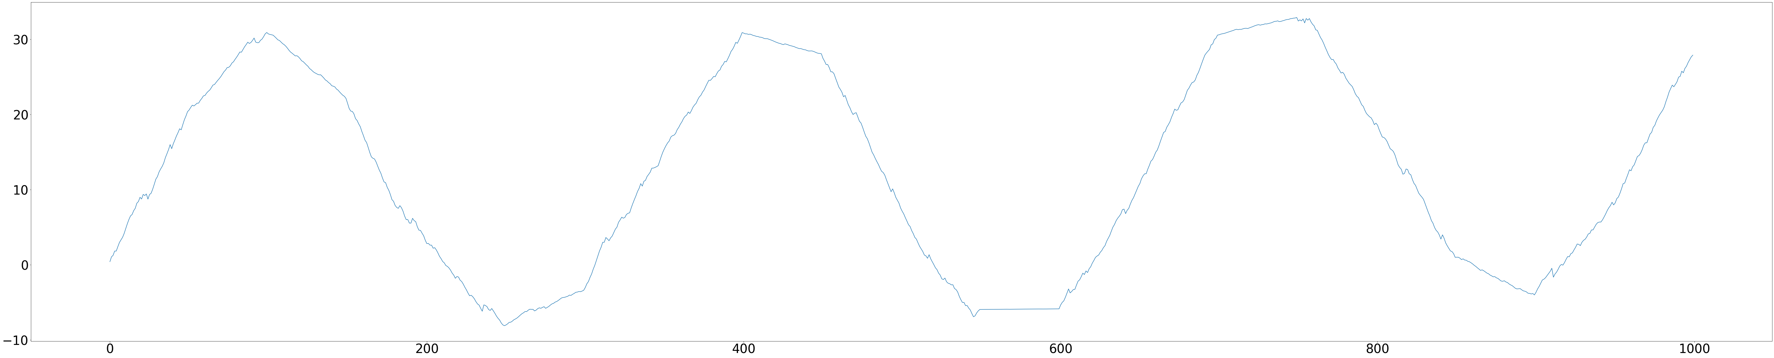
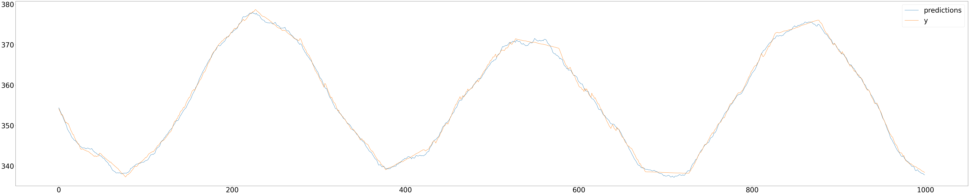
Toy Example – Synthetic Data
Synthetic Signal 1 – Model trained and deployed
Synthetic Signal – Predictions vs Actual

Slide 13
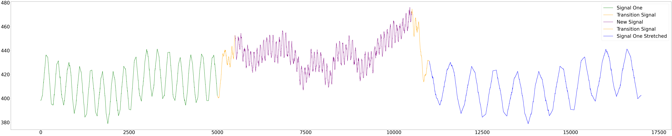
Test Case – The Data Shift
Signal One –
Training & Deployed Model
Transition Signal
Signal Two
Transition Signal
Signal Three (=Signal 0ne Stretched)

Slide 14
Test Case – Training Procedure
It. 1
It. 2
It. 3
.
.
.
Training input: 4000 timesteps
Evaluate MSE: 100 timesteps
Training input: 4000 timesteps
Evaluate MSE: 100 timesteps
Training input: 4000 timesteps
Evaluate MSE: 100 timesteps

Slide 15



System Components
Machine Learning Services
Data
Business Flow Control
Production
Trainer
Production Static
Monitoring Server
Dashboards
Monitoring and Observability Services

Slide 16








Technology Stack
Why ML Pipeline with VSC?
Why Storage for model registry?
Why docker-compose?
Notes:
There is no ML Pipeline as such. There are some modules. Data simulation module, preprocessing module, metadata module.
Why? Because the API's do very similar things but not exactly the same. So we build very small components which we then could call from different API ensuring a function returns the same in all api without updating other parts of the code.
Using an ML pipeline tool would have required to build several pipelines in order to meet requirements.
Why storage as a model registry? Because of the same reason we used docker compose. Docker compose is a containerization method in which several containers reside in the same host. That way the system can be easily run on premise or in the cloud.

Slide 17


This system can be downloaded and run on-premise
Notes:
We believe many people would have concerns to upload a succesful bot to the cloud. That is why we chose these options.

Slide 18
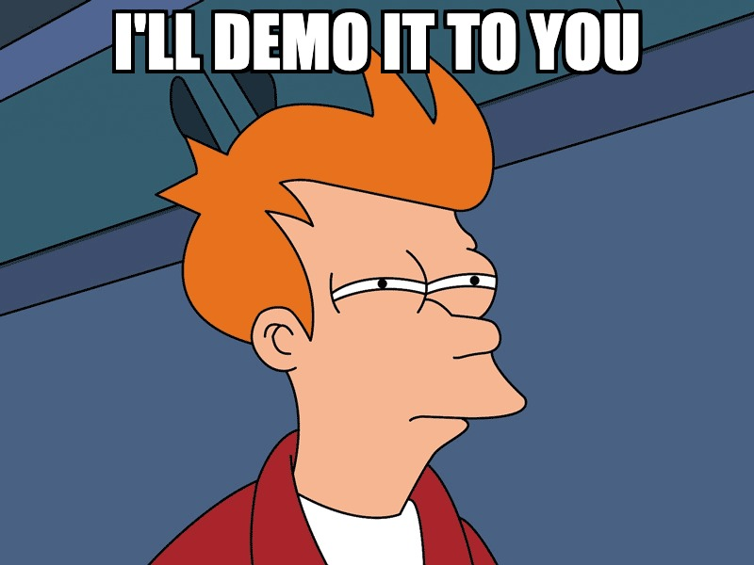

Slide 19
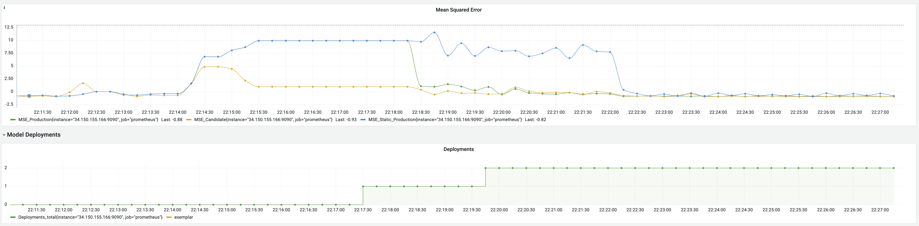
Technology Stack

Slide 20

Future Work
We are working with a bot company
Goal
Create an intelligent bot rule optimization system
Implement backtesting module
Key module of the system.
System Portability
Translate C# bot definition to python
Machine Learning Components
Decision gate
Generic Connector
Analyse feasibility to develop a generic connector for Ninja Trader
Analyze options to integrate with platforms that use python (Trality, Lemon Markets, etc)
Dynamic Container Creation
Implement automatic docker creation for substituted bots and compare their performance.

Slide 21
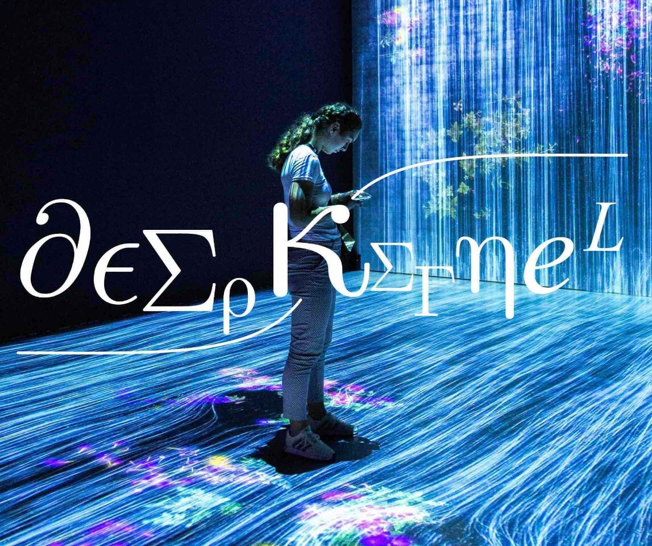
Francesc Balada MLE@deepkernel.ai
University Degrees:
Business Administration @UPF - 2001
Computer Science (120/180 credits) @UOC – 2008
Master of Science in Predictive Analytics @NU - 2014
Advanced Degree in Data Science @NU - 2017
Working Experience:
From 2001 to 2012:
Business Intelligence Consultant to Operation Manager Europe
From 2012 – currently
Senior Business Intelligence Consultant
@A1 Telekom Austria | Contractor
Data Scientist
@Hutchison Drei Orange | Contractor
Data Scientist
@Airbus | Contractor
Lead Data Scientist
@Lufthansa Group | Contractor + Permanent
Machine Learning Developer and Research Teammember
@RISE | Permanent + Contractor

Slide 22


Slide 23
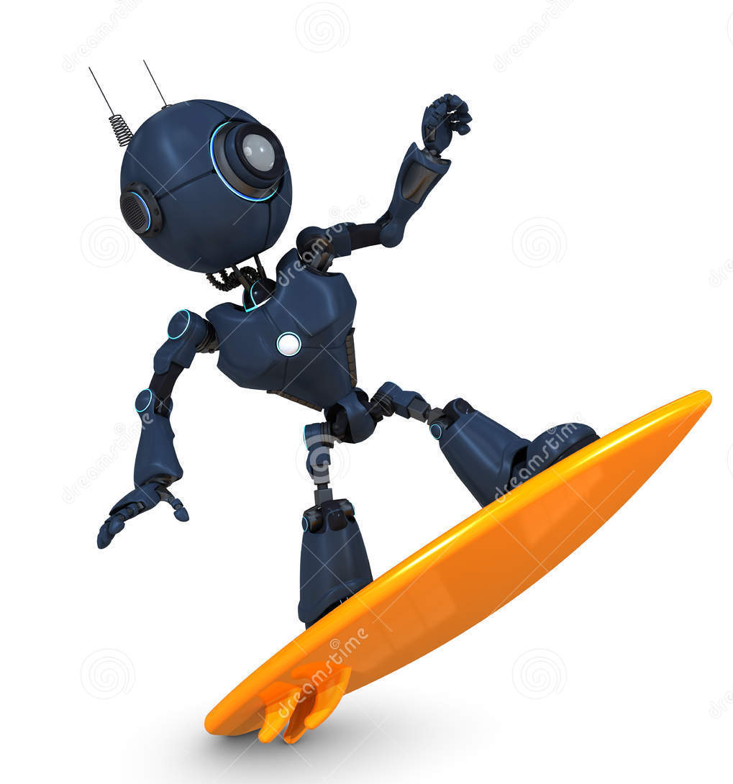

Trading bots surfing the stock markets
Your bots
Lagard’s competition bots

Slide 24
Leverage the opportunities
What are the type of bots
Trend Trading Bots
Arbitrage bots
Coin lending bots
Market maker bots
Mean-reversion strategies
Trend-following strategies
Breakout strategies
Biased strategy
…
…

Slide 25











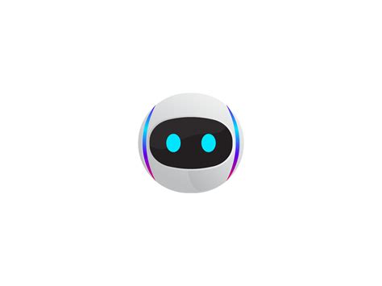

1 Megatron of data

Slide 26
Title
Outline
Problem
Solution
Data + Model
Demo
MLOps Stack
Conclusions
Future Work

Slide 27
https://therobusttrader.com/what-percentage-of-trading-is-algorithmic/
https://towardsdatascience.com/which-trading-bots-are-even-profitable-eaab72c60e69
https://automatedcryptobots.com/types-of-cryptocurrency-trading-bots/

